Slide 1
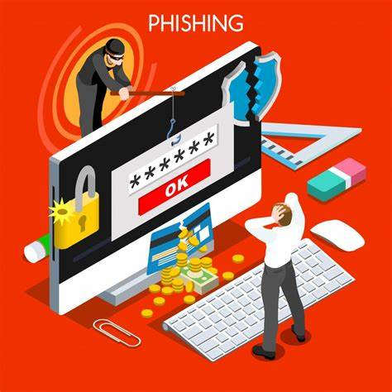
Phishing Awareness Training
Phishing is a common cyberattack that targets individuals and organizations alike. It involves criminals attempting to trick people into revealing sensitive information, such as passwords, credit card details, or personal data, through deceptive emails, websites, or text messages. This training will equip you with the knowledge and skills necessary to identify and protect yourself from these malicious attacks.

Slide 2
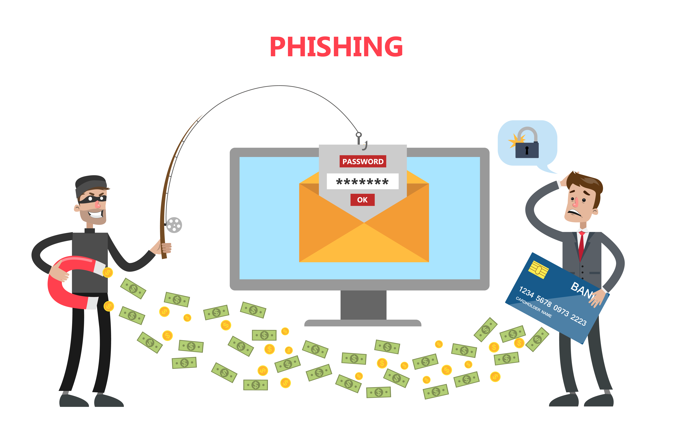
What is phishing?
Phishing is a form of social engineering that leverages deceptive tactics to trick individuals into revealing sensitive information. It often involves creating fake emails, websites, or text messages that mimic legitimate sources, such as banks, financial institutions, or trusted organizations. These malicious attempts aim to steal personal data, financial information, or even access to your accounts.

Slide 3
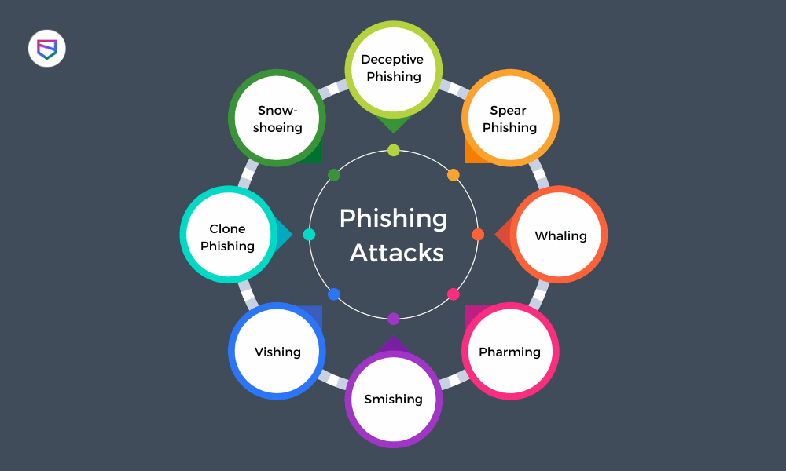
Common phishing tactics:
Phishing attacks employ various tactics to lure unsuspecting victims. Some common methods include:
Impersonating a trusted entity, such as a bank, online retailer, or government agency.
Creating a sense of urgency, often using threats or deadlines, to pressure victims into taking immediate action.
Exploiting current events or popular trends to make their messages seem more relevant and believable.
Using social engineering techniques to manipulate victims into clicking on malicious links or opening attachments.

Slide 4
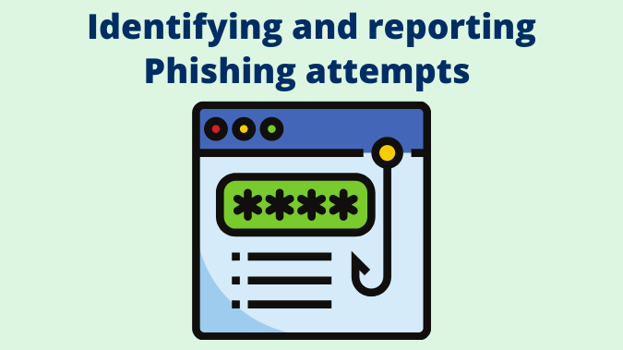
Identifying phishing attempts:
Recognizing the signs of a phishing attempt is crucial to protecting yourself. Here are some red flags to look out for:
Suspicious sender addresses or domains
Urgent requests for personal information
Links that don't match the expected destination
Grammar or spelling errors
Unfamiliar logos or branding

Slide 5

Protecting yourself from phishing:
There are several steps you can take to protect yourself from phishing attacks:
Be cautious of suspicious emails, websites, or text messages
Hover your mouse over links before clicking to verify the destination
Never click on links or open attachments from unknown senders
Use strong and unique passwords for all your accounts
Enable two-factor authentication whenever possible
Keep your software up to date with the latest security patches

Slide 6
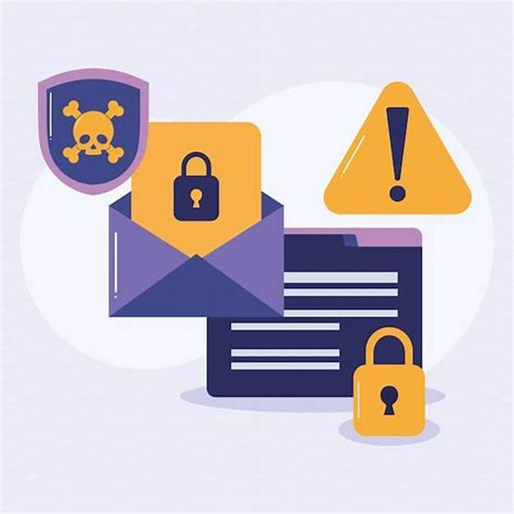
Reporting suspected phishing:
If you encounter a suspected phishing attempt, it's important to report it. You can do so by:
Contacting the organization that the phishing email or website is impersonating
Reporting the attack to your IT department or security team
Forwarding the suspicious email to a designated phishing reporting address

Slide 7
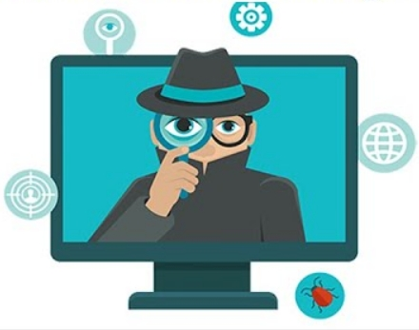
Consequences of falling for phishing:
Falling victim to a phishing attack can have serious consequences, including:
Identity theft
Financial loss
Compromised accounts
Malware infection
Damage to your reputation

Slide 8
Phishing prevention best practices
Employee Training
Regular phishing awareness training programs are crucial to educate employees about phishing tactics and best practices for identifying and avoiding these attacks.
Strong Passwords
Encourage employees to use strong and unique passwords for all their accounts and avoid using the same password across multiple platforms.
Security Software
Investing in robust security software, such as antivirus and anti-malware solutions, can help detect and block phishing emails and websites.
Two-Factor Authentication
Implement two-factor authentication, which requires an additional layer of security beyond a password, to further protect sensitive accounts.

Slide 9
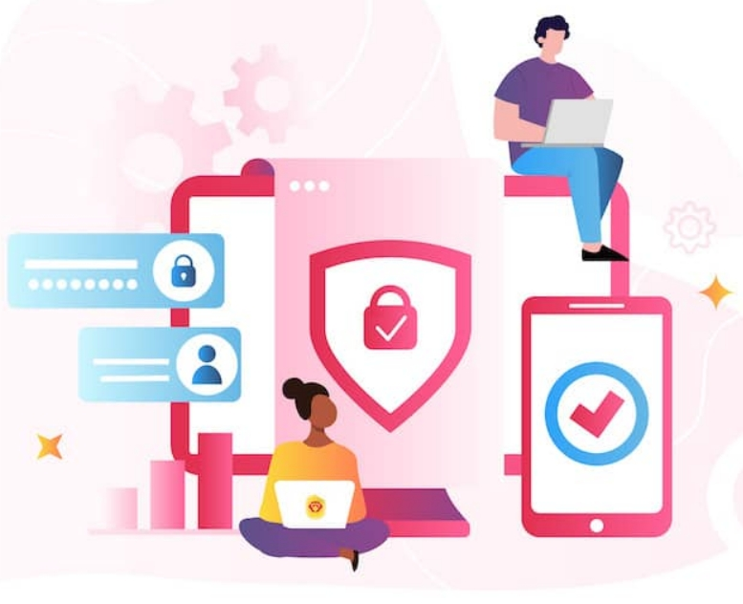
Ongoing phishing awareness and training
Phishing attacks are constantly evolving, so it's crucial to stay vigilant and keep your employees informed. Regularly update phishing awareness training programs to reflect the latest threats and tactics. Encourage employees to report any suspicious activities and promote a culture of security within the organization.

Slide 10
Thank you
E-mail: tarunaantil21@gmail.com
LinkdIn:www.linkedin.com/in/taruna-antil-1a252b317

